Slide 1


Mobile Flashcard App with
Spaced Repetition
Building Efficient Learning Tools with Rust
Group 13
December 2025

Slide 2


Module Positioning: The Software's Underlying Engine
Core Positioning
Responsible for database and core business layer modules,
serving as the "underlying engine" of the flashcard software
Module Functionality
Supports upper-layer function implementation, ensuring data
flow and business logic execution
Presentation Logic
Positioning → Value → Demonstration → Connection,
highlighting the module's core supporting role in the software

Slide 3
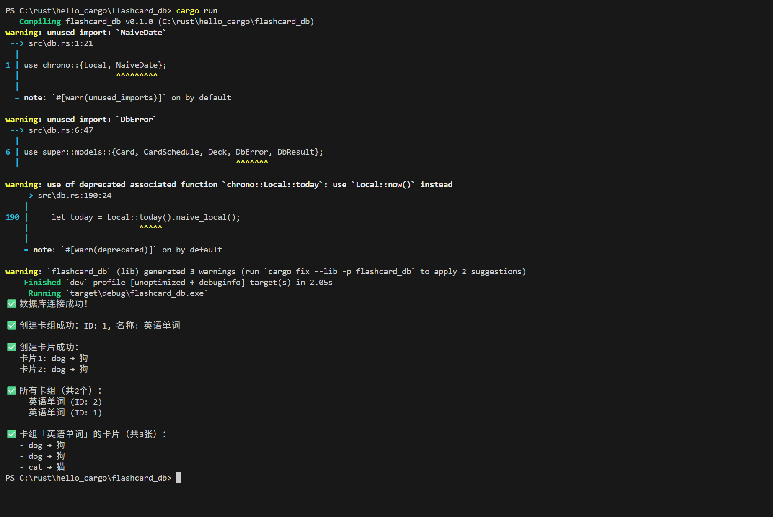
Core Value 1: Stable Data Storage
01
Database Engine
Adopted SQLite as the database engine
02
Core Table Design
Ensures card progress is not lost
03
Foreign Key Association
Guarantees data consistency and integrity
Notes:
"First page: I used SQLite for data storage and built core tables—like tables for words and review progress. This way, users’ words and how far they’ve gotten with reviews will never be lost. I also added 'connection locks': delete a card set, and its words are deleted automatically—no messy data.
(Point to the terminal screenshot on the right) See? Creating the 'English Words' set and adding the card 'dog→dog' both saved successfully."

Slide 4
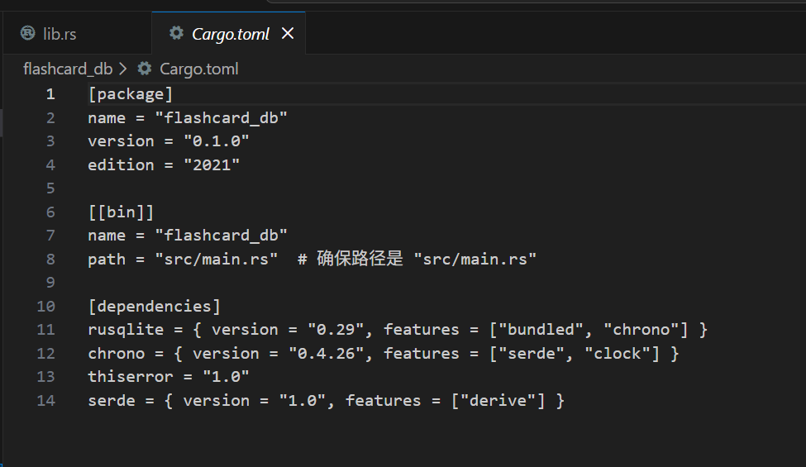
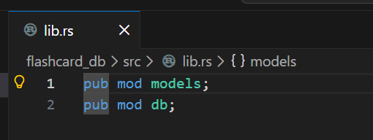
Core Value2: Logical decoupling
01
Interface Standardization
Design unified business layer interfaces (such as data CRUD, learning progress calculation interfaces)
02
Decoupling Advantages
Upper modules don't need to focus on underlying implementations, reducing coupling and improving development efficiency
03
Scalability Description
Interfaces can adapt to future functional iterations and database replacement requirements
Notes:
"Next is the 'divide and conquer' design:
(Point to the lib.rs screenshot on Page 2) I turned data functions into 'ready-to-use tools'—teammates don’t need to worry about how data is stored; they can just use them directly.

Slide 5
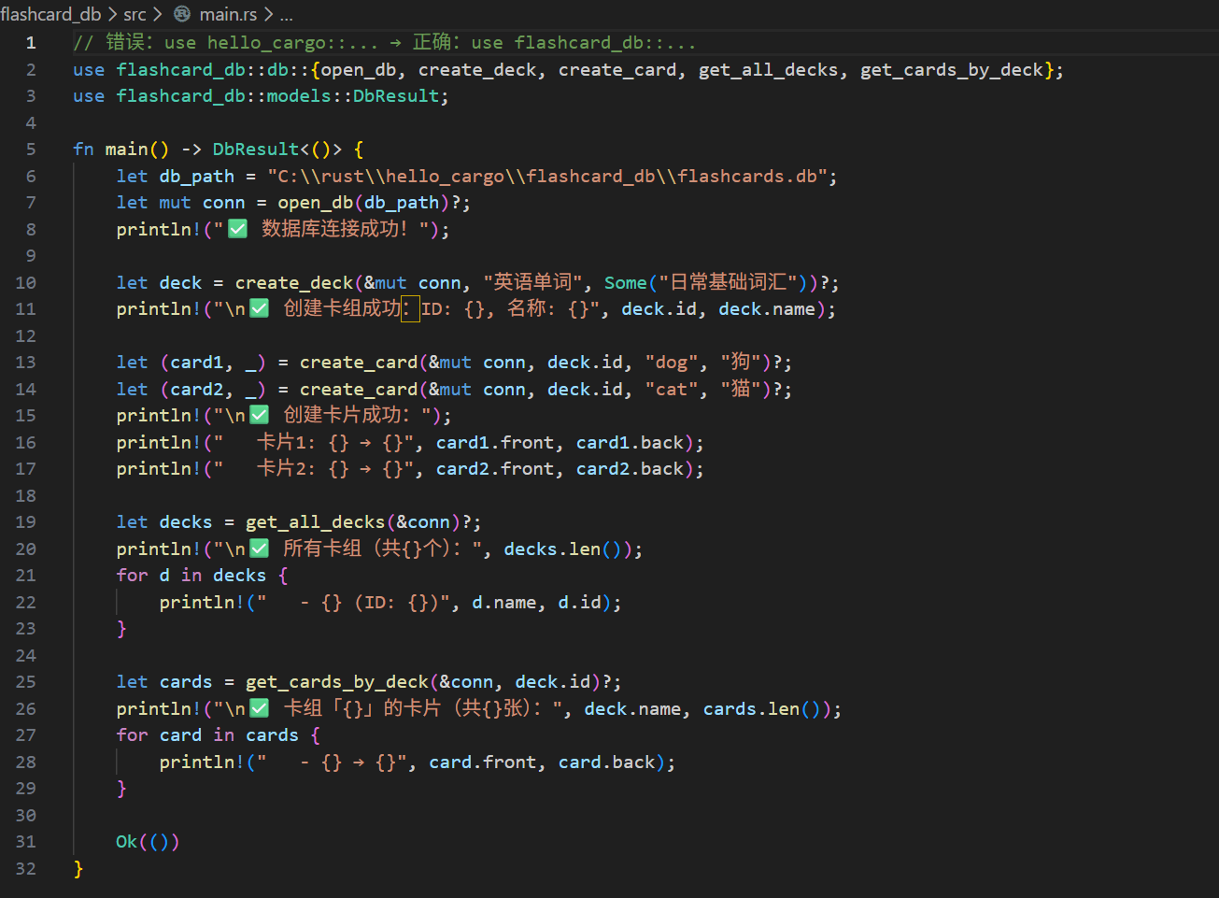
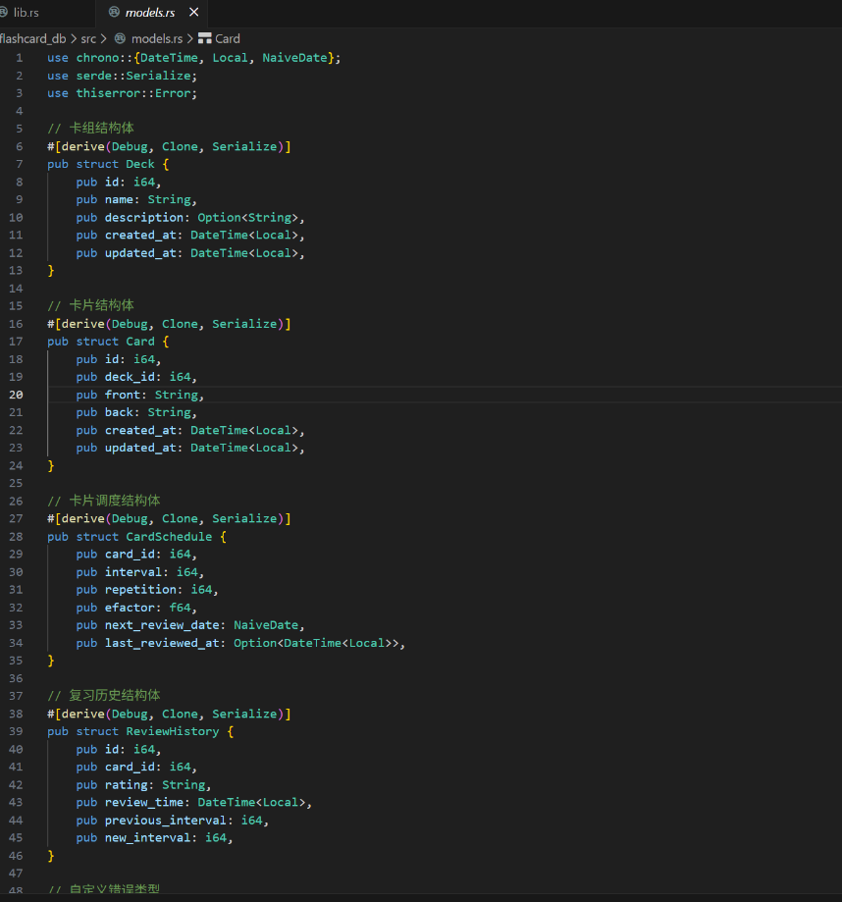
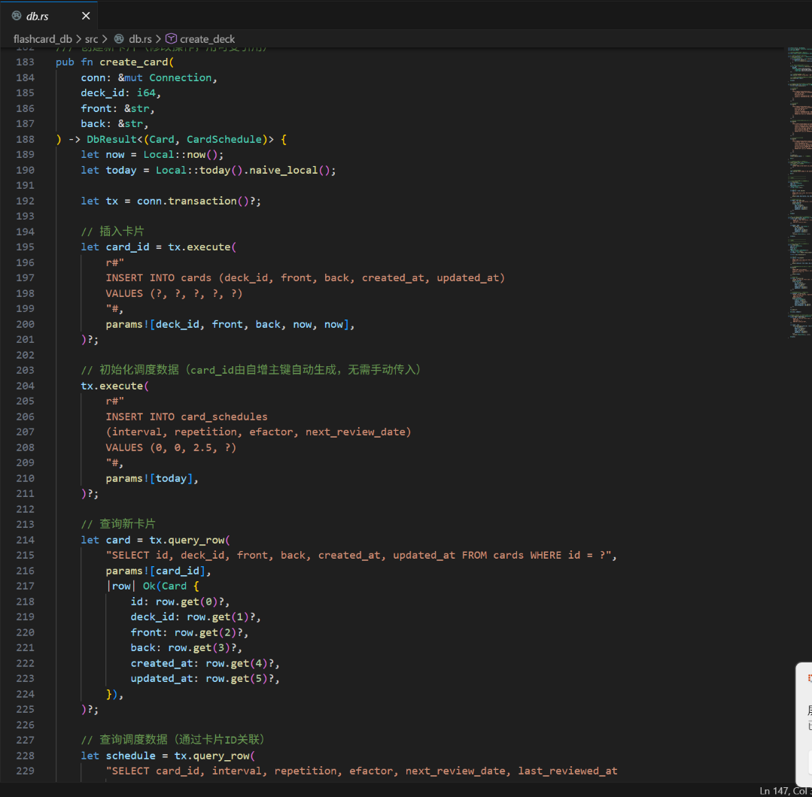
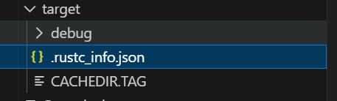
Core Value2: Logical decoupling
Notes:
Take the create_card tool, for example: teammates pass the 'word + meaning', and I automatically save it plus record the review time. The interface team doesn’t need to write data code, and the review logic team doesn’t need to handle storage—double the efficiency."

Slide 6
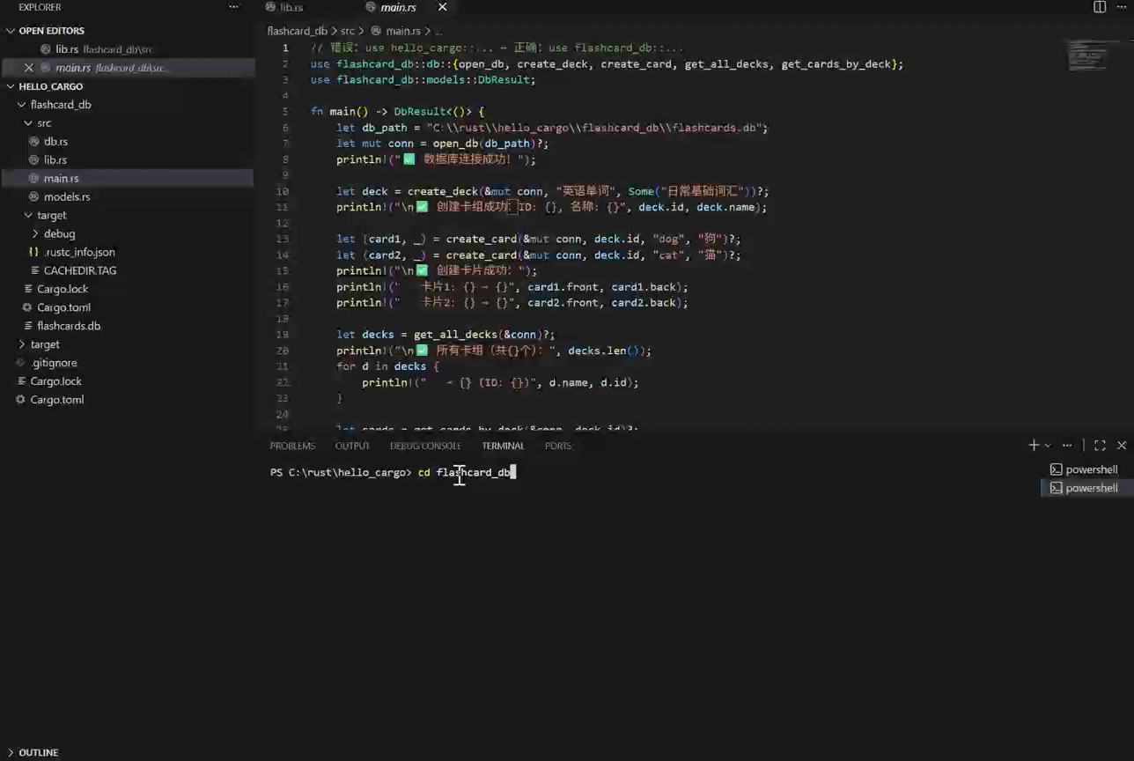
Function Verification
Output Display
Present key results of database initialization, data loading, and business logic execution
Effect Verification
1
Verify module functionality and smooth data flow
2
3
Notes:
"Let’s see the actual effect:
(Point to main.rs and the terminal) After running the code, the database connects successfully, card sets and words are created, and data can be retrieved normally—all these results are ready for the interface team to use later."

Slide 7
Overall Project Value
Underlying Support Functionality
Provides reliable data storage and business logic foundation for flashcard software
Efficiency Improvement
Standardized interfaces reduce upper-layer development costs and accelerate project iteration
Stability Assurance
Data consistency design reduces system error risks
Notes:
"To sum up my module:
●It protects the 'data lifeline' of our flashcard app;
●It lets teammates focus less on data and more on building the interface and optimizing review logic;
●Neat data means the app is less likely to have issues."

Slide 8

Responsible Module: Interactive Interface Layer
Core Function
Core Positioning
Module Value
Transform raw database data into
The 'experience bridge' connecting
Determines users' first impression
intuitive, seamless user interaction
databases and users
and stickiness with the software
experiences

Slide 9
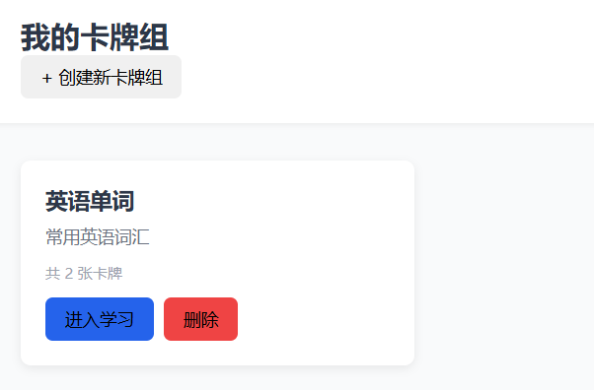
Card Deck List Page（index.html）
Function
English Learning Deck Management Portal, supporting deck addition, deletion, and detailed view navigation
Element
Card deck title, create button, existing card deck list (displaying card deck name, description, number of cards, and operation buttons)

Slide 10
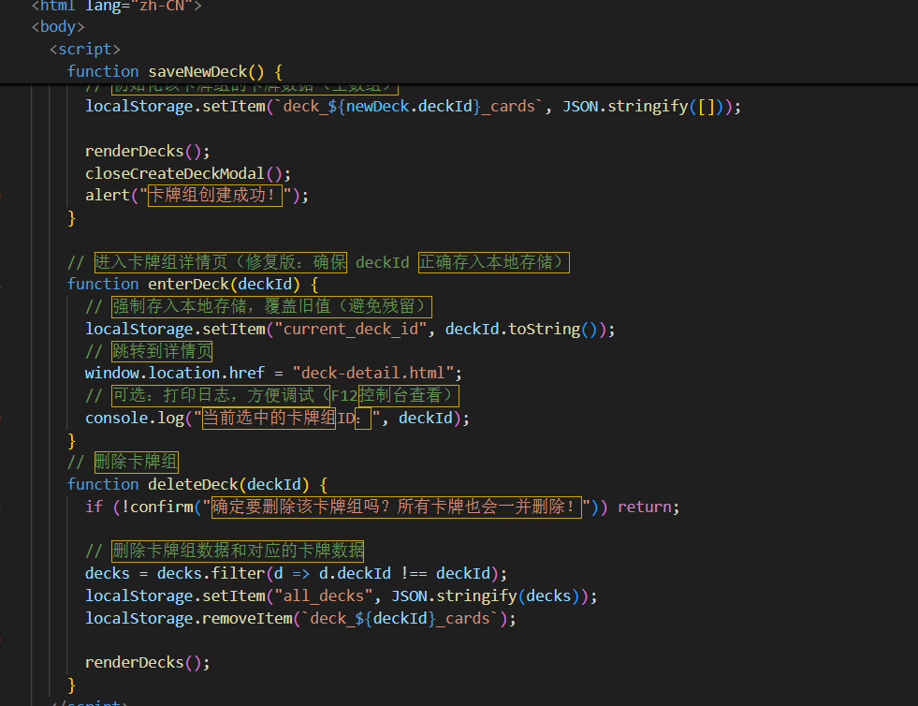
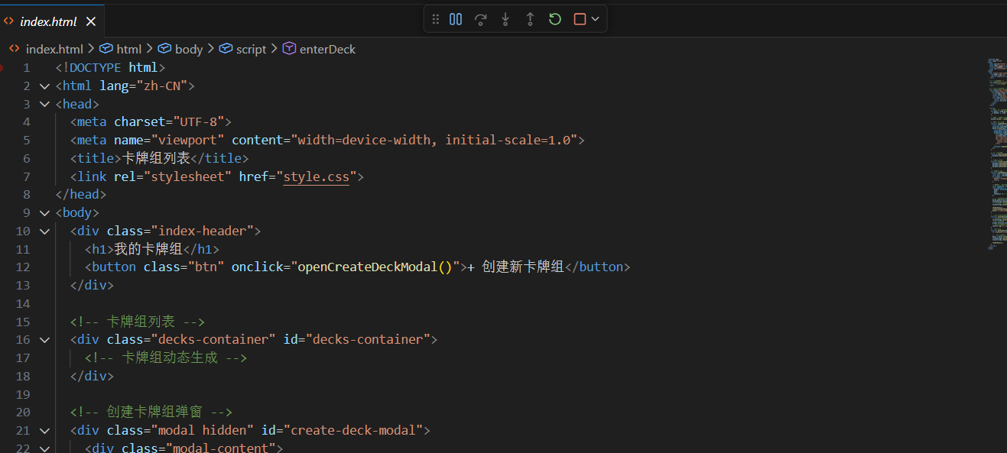
Card Deck List Page（index.html）

Slide 11
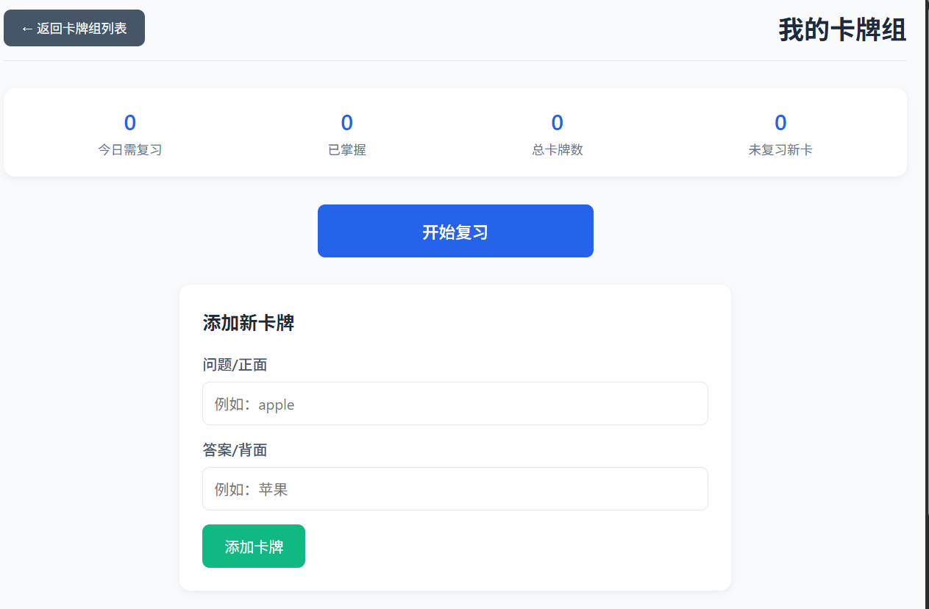
Card Deck Details Page （deck-detail.html）
Function
Display English learning cards within the card deck, supporting single card viewing, editing, and deletion
Element
Card group information display, card list (including words, definitions, example sentences, etc.), operation buttons

Slide 12
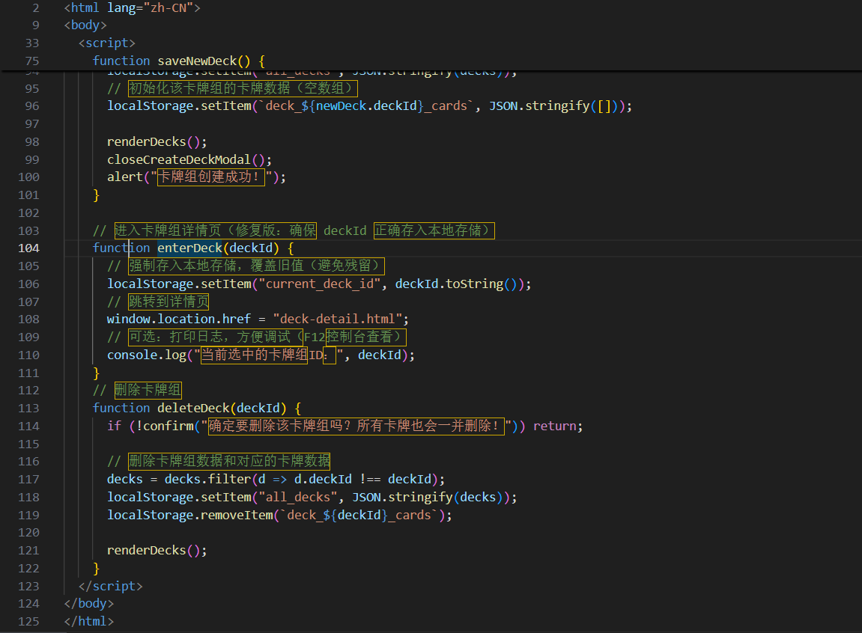
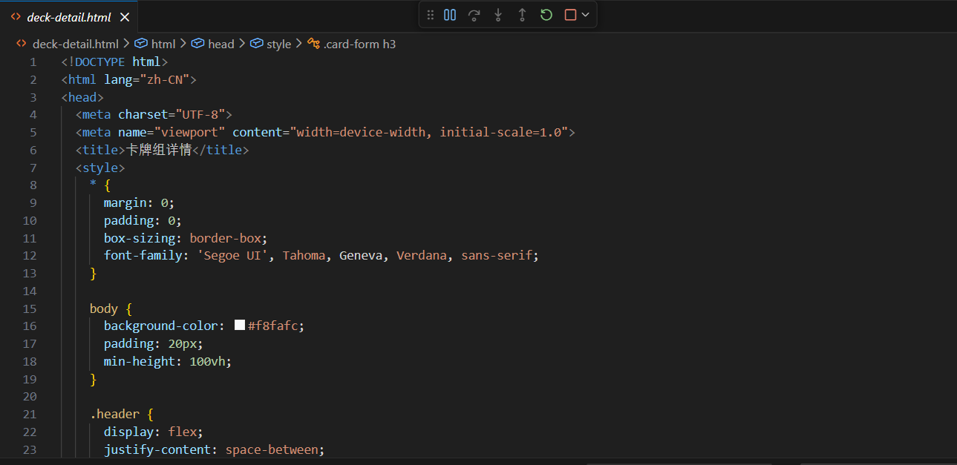
Card Deck Details Page （deck-detail.html）

Slide 13
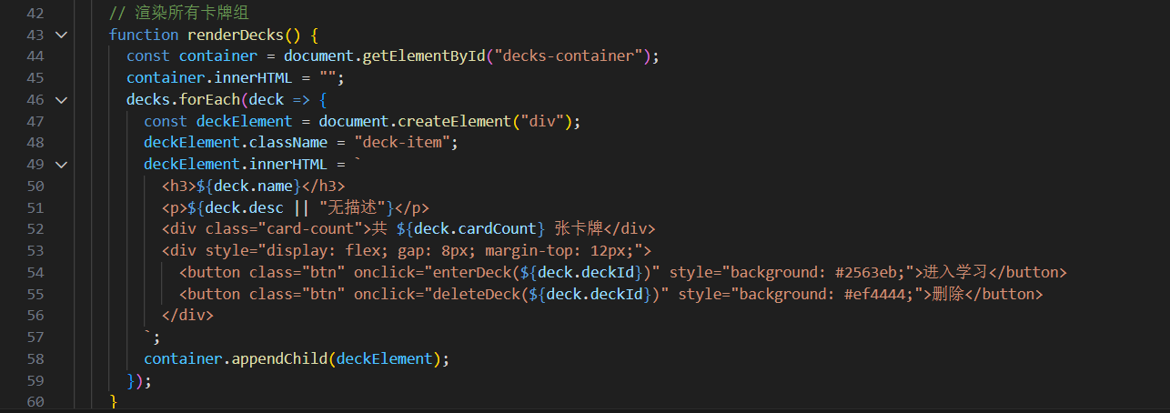
Core Value 1: Dynamic Interface Generation
Data-Driven UI Concept
01
Mechanism: Data changes → automatic rendering without manual DOM manipulation
02
Technical Implementation: Real-time interface updates through render function associated with data arrays
03
Advantages: Clean and maintainable code, suitable for scenarios with frequent data changes

Slide 14
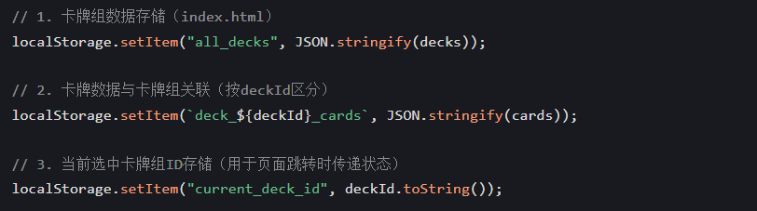
Core Value 2: Structured State Management
Efficient Data Storage and Transfer
Storage Structure: deck_${deckId}_cards for categorized card data storage
Persistence Solution: JSON serialization for localStorage data persistence
State Transfer: current_deck_id for unified management of current deck state

Slide 15
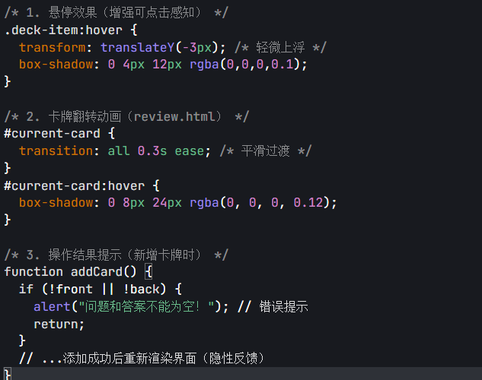
Core Value 3: Interactive Experience Optimization
Visual Feedback & Responsive Design
Dynamic effects: Card flip animations and button hover
feedback enhance operational experience
Responsive adaptation: Automatically adjusts to
mobile/tablet/PC screen sizes
Experience details: Learning progress visualization and
⼊⼝
difficulty evaluation interaction

Slide 16
Value to the Overall Project
Strategic Significance of the Experience Layer
01
Data Transformation: Convert raw database data into interfaces that users can "understand and enjoy using"
02
Experience Enhancement: Smooth interactions reduce cognitive load for vocabulary learning and increase learning
enjoyment
03
Ecosystem Integration: Provide intuitive interaction entry points for algorithm-layer review plans
04
Business Value: High-quality experiences drive user retention and word-of-mouth promotion

Slide 17

Conclusion: The Mission of the
Experience Layer
The Final Link Connecting Technology and Users
Summary: The interface layer is the only window through which users
perceive the value of technology
Transition: Now users can intuitively utilize underlying data and algorithmic
functions through the interface

Slide 18

Feature Overview
Smart Card Review Feature: Core Learning Scene Module
01
Objective
02
Positioning
03
Core Process
Focus on "efficient memory", providing
Core learning scene module to help
Complete loop from initialization loading
an immersive and feedback-driven
users consolidate knowledge memory
→ review interaction → statistical
review experience based on spaced
feedback
repetition logic

Slide 19
Technical Architecture
Three-Tier Architecture Design
HTML Structure Layer: Builds basic page layout and components
Style Layer: Defines UI styles and interaction feedback for cards, buttons, etc.
Core Logic Layer: Implements core functions such as data loading, interval repetition, and interaction control
Data Storage
Uses localStorage for local data persistence, with reserved extension interfaces for backend integration

Slide 20
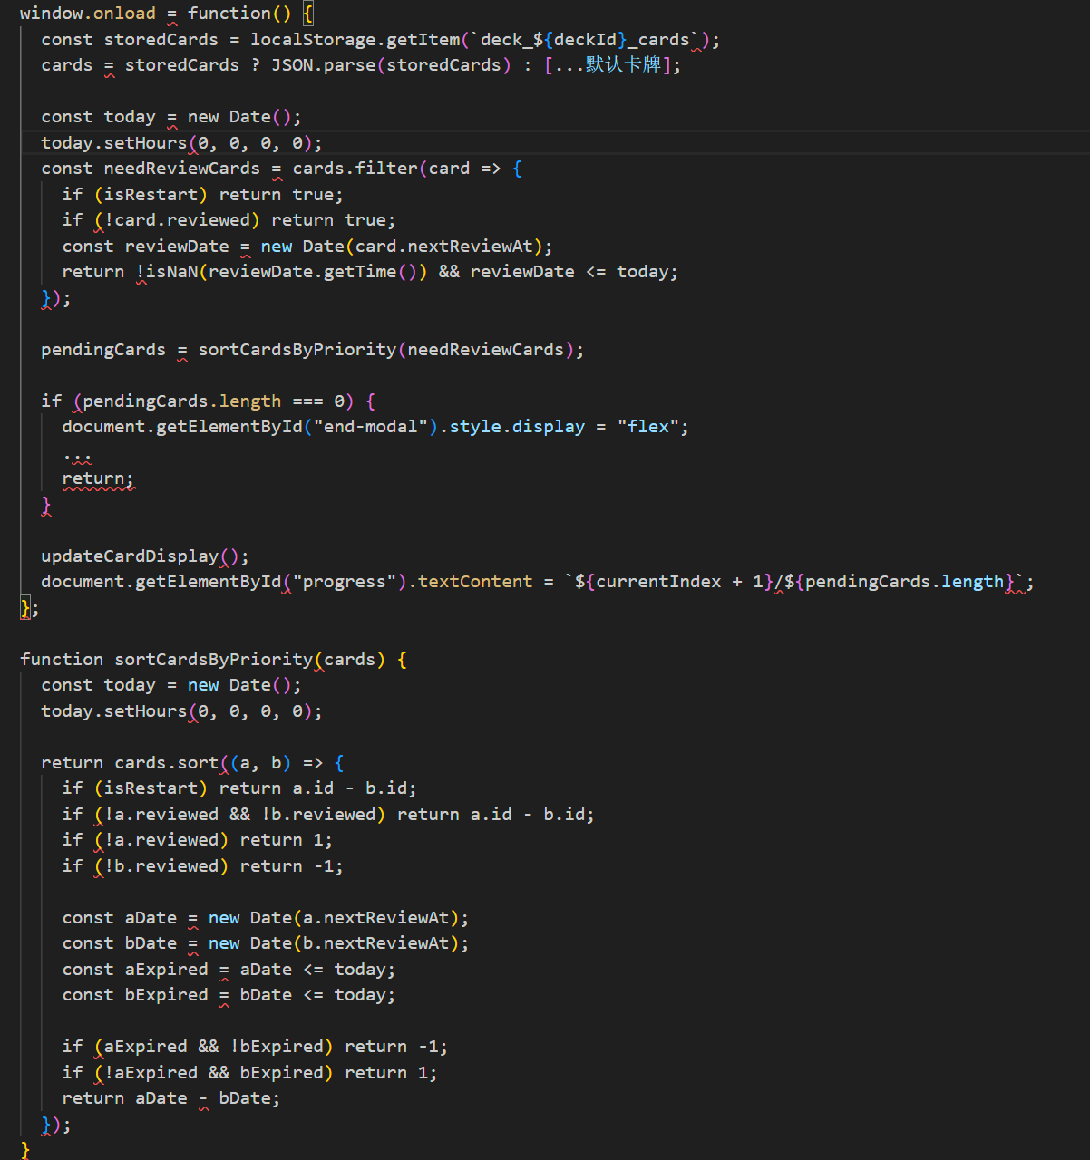
Page Initialization and Data Loading
Data Source & Filter Rules
Data Source: Reads card data from localStorage, uses default cards when no data exists.
Filter Rules:
1. Return all cards in re-review mode
2. Priority to unreviewed cards
3. Priority to expired cards (nextReviewAt ≤ today)
4. Sort by nextReviewAt timestamp
Edge Cases & Progress Display
Edge Case Handling: Display completion modal when no cards need review.
Progress Display: Real-time update of current review progress （e.g.¼)

Slide 21
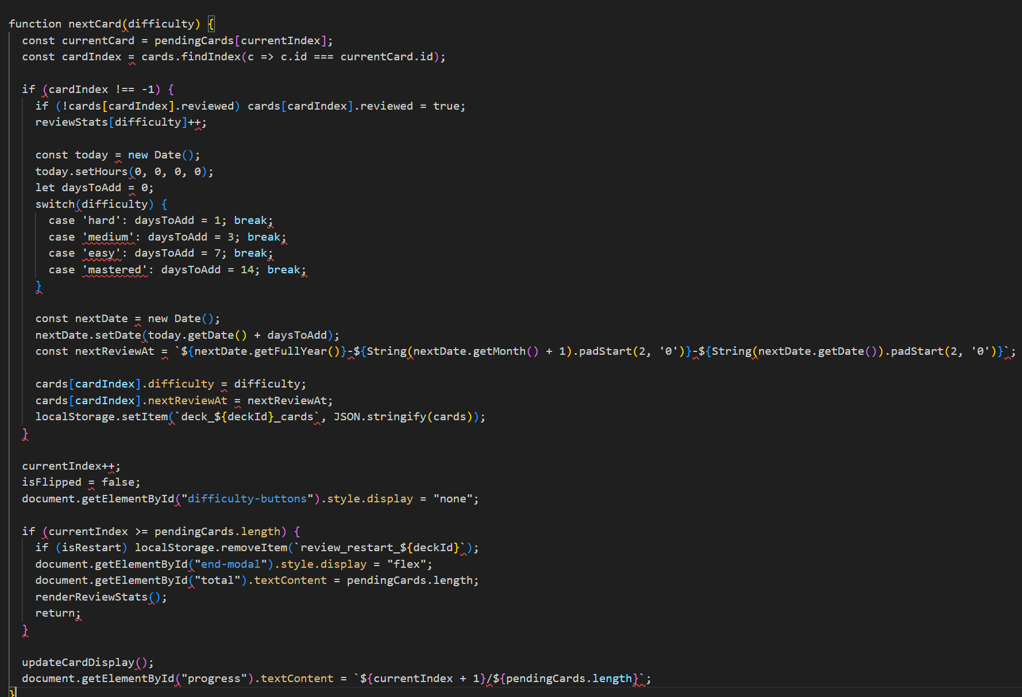
Card Flip Interaction
01
Flip Trigger
Click the card to trigger flip state switching
02
Content Switching
Front side displays front content, back side displays back content
03
Button Control
Difficulty marker button appears when flipped to back, hidden when on front
04
Review Reason Prompt
Displays corresponding prompt information based on card status (e.g., "Review Again: Strengthen memory and consolidate mastery")

Slide 22
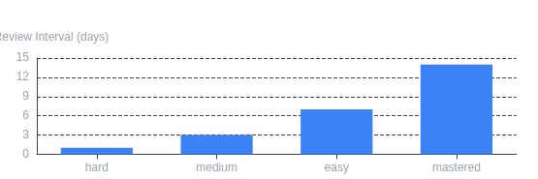
Difficulty Marking and Review Interval Updates
Spaced Repetition: Dynamically Adjusting Review Cycles Based on Difficulty
Difficulty Mapping: hard (1 day), medium (3 days), easy (7 days), mastered (14 days)
Data Update: After marking difficulty, update card's difficulty and nextReviewAt fields
Storage Synchronization: After update, re-store card data to localStorage
Process Advancement: After completing current card, automatically load next one; after all completed, display completion modal
Correspondence Between Difficulty Levels and Review Intervals

Slide 23
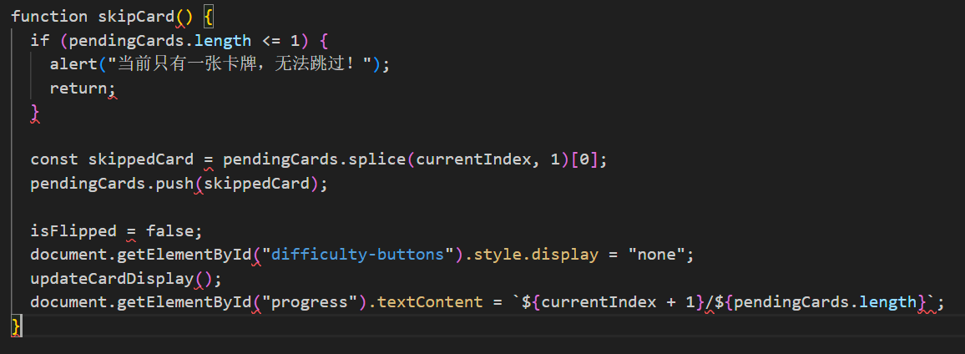
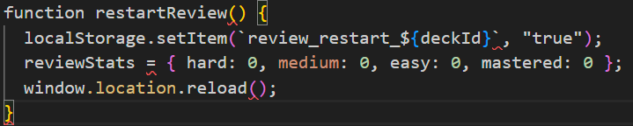
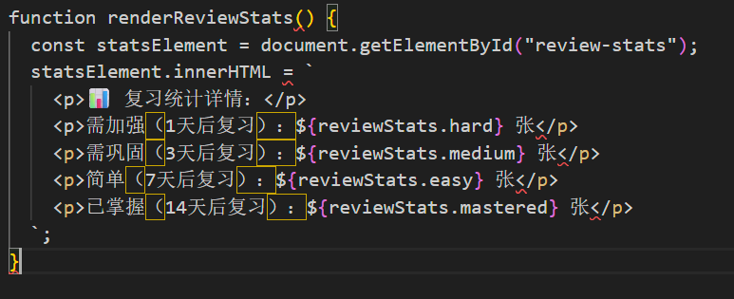
Accessibility Implementation
01
Skip Card
Move current card to the end of the review queue, supporting review order adjustment (edge case: skip disabled when only 1 card remains)
02
Restart Review
Reset review status and reload all cards for review
03
Exit Review
Support exiting the current review process at any time
Notes:
1. Core Interactions
We built three key features:
•Skip Card: Moves the current card to the end of the queue, with a boundary check—if only 1 card remains, it prompts "Cannot skip" to avoid invalid actions.
•Restart Review: Uses local storage to mark the restart state, resets review stats, and reloads the page for a fresh session.
•Exit Review: Lets users quit anytime, and renders stats for different priority cards (like "needs reinforcement") to keep progress clear.

Slide 24
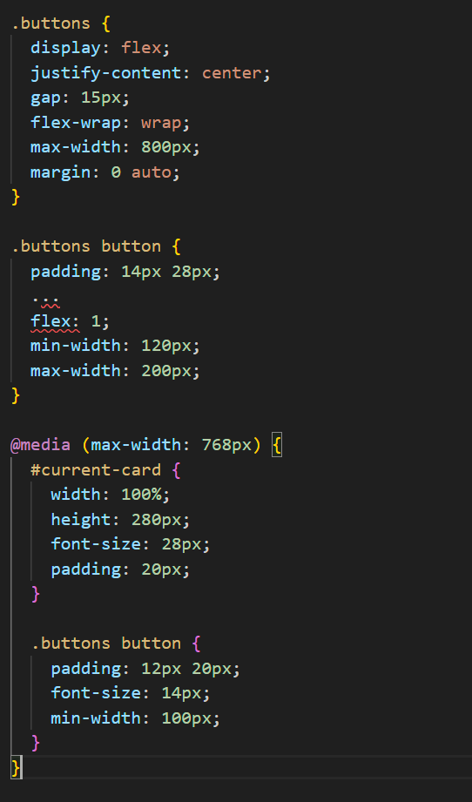
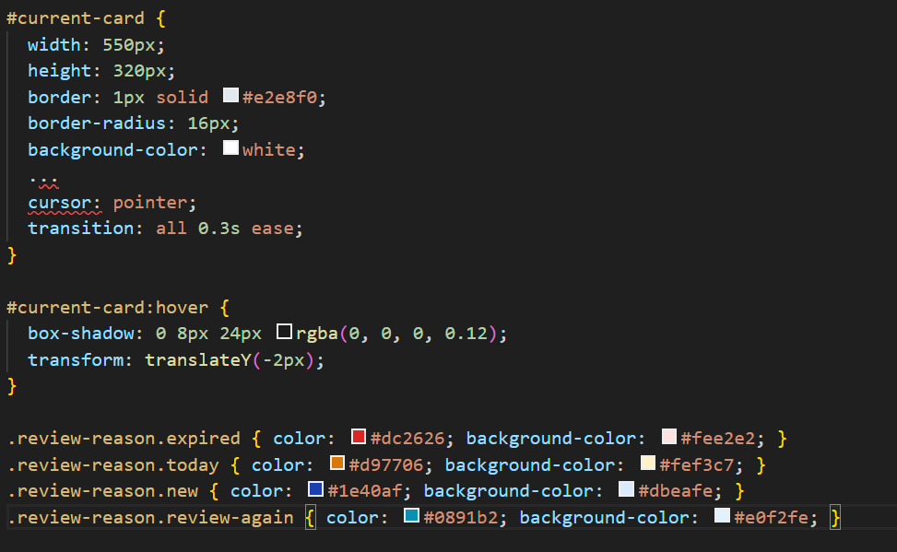
Accessibility Implementation
05
Button Layout and Responsive Design
Standardization and beautification
04
Style and Interaction Feedback
Optimize the operational feel and assist in immersive learning
Notes:
2. UX & Responsiveness
•Hover effects for cards: Slight lift + shadow with a 0.3s transition for immersive interaction.
•Distinct colors for review states: Red for "expired", yellow for "new" (and other states) for visual clarity.
•Mobile responsiveness (under 768px): Cards auto-shrink and button padding adjusts for usability on small screens.

Slide 25
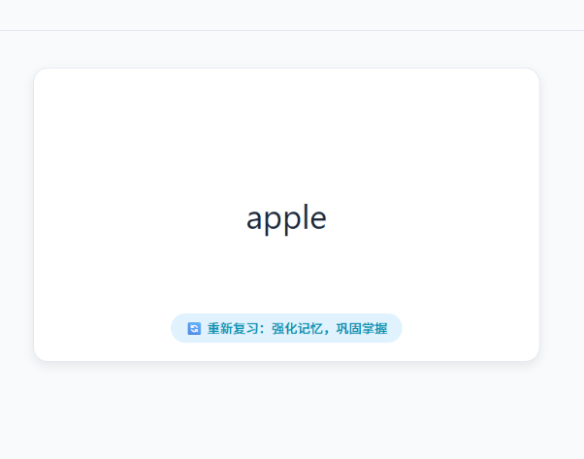
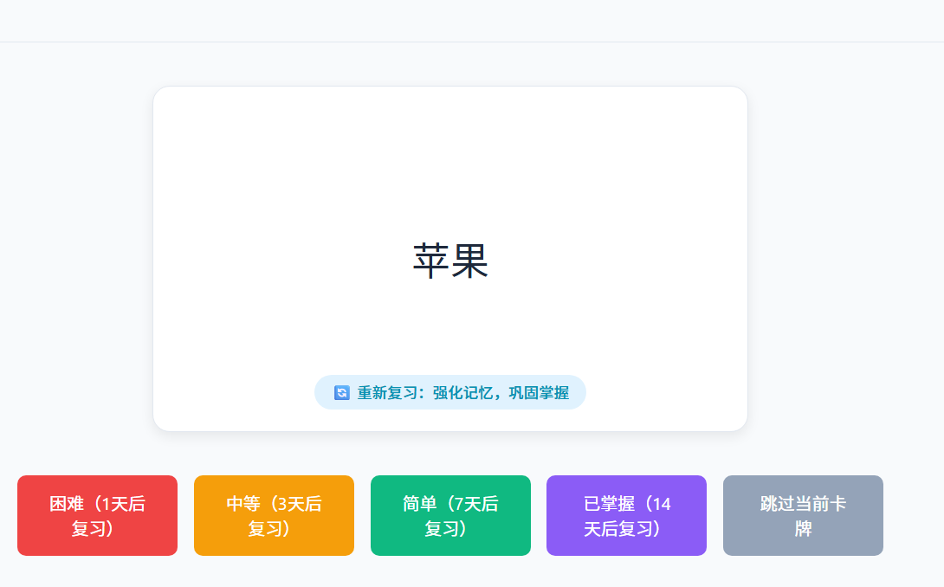
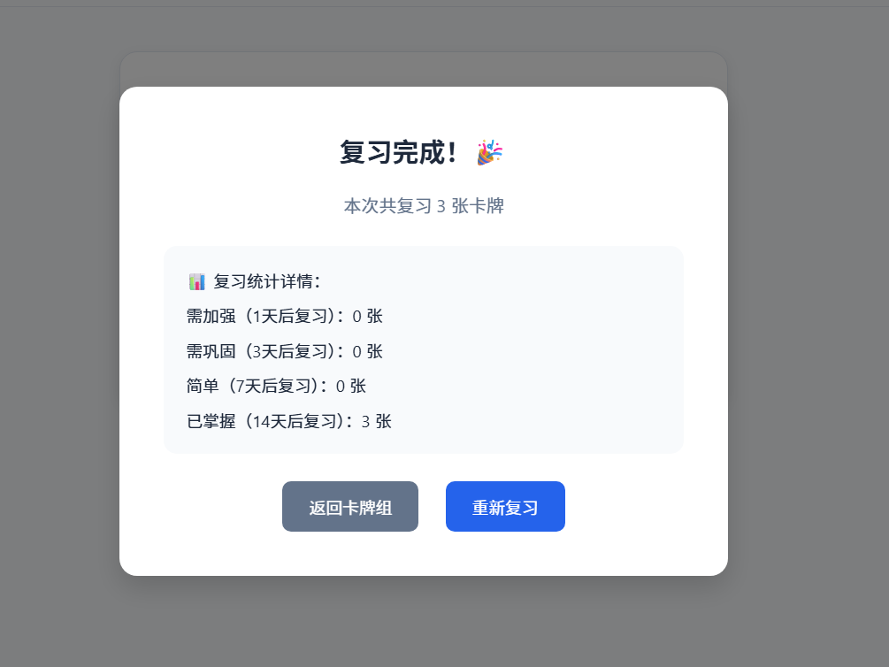

Functional Effect Diagram Display
Actual Effect: Restoring Design and Requirements
Review interface: Display card front/back, review reason prompts, progress bar
01
/
02
Difficulty marking interface: Display difficulty buttons and skip option
03
Review completion interface: Display statistical details and operation entry
04
Responsive adaptation: Automatically adjust card size and button layout on mobile devices
Notes:
3. Live Effects
•Review interface: Displays card front/back + prompts (e.g., "strengthen memory").
•Difficulty panel: Equipped with Hard/Medium buttons + skip function.
•Completion flow: A stats popup shows card distribution, with options to "return to deck" or "re-review"—ensuring a smooth end-to-end experience.

Slide 26
Summary
Project Highlights
1. Demand-driven code: Each functional requirement is implemented by a corresponding code module, with no redundant logic.
2. Scalability reservation: Local storage operations can be directly replaced by API requests to meet the expansion requirements of "connecting to the back end".
3. User experience first: Boundary handling (such as no card prompts, skip restrictions) and interaction feedback (such as flip animations, hover effects) are all designed around user experience.
4. Logical closed loop: From initialization → review → completion → statistics, a complete code logic chain is formed, meeting the requirement of an "end-to-end review process".
Notes:
4. Project Highlights
•Demand-driven code: Each feature maps to a modular function, with no redundant logic for easy maintenance.
•Scalability: Local storage can be directly swapped for API calls, ready for backend integration.
•User-first design: From boundary checks to animations, all elements center on enhancing user experience.
•Closed-loop logic: Covers initialization → review → completion → stats—a full end-to-end workflow.

Slide 27


Core Objectives
Build Stable Interfaces
Integrate Desktop Applications
Implement Complete Workflow
Build stable and user-friendly backend interfaces for algorithm modules
Successfully integrate interfaces into desktop applications
Implement a complete workflow from data layer to interaction layer
Notes:
大家好，接下来由我分享我负责的算法API封装部分的开发过程。
Hello everyone, I will now share the development process of my responsibility—the Algorithm API encapsulation.
我这次工作的核心目标，是为我们的算法模块构建一个稳定、易用的后端接口，并把它成功集成到我们的桌面应用中。
The core objective of my work was to build a stable and user-friendly backend interface for our algorithm module and successfully integrate it into our desktop application.
我的工作主要分三步走：
My work mainly proceeded in three steps:

Slide 28
Build a Solid Data Foundation
01
Complete the integration of algorithm API with SQLite database
02
Implement reading of raw data and writing back of processing results
03
Ensure the algorithm has reliable data sources and storage space
04
Lay the foundation for functional implementation
Notes:
第一步，是筑牢数据地基。我首先完成了算法API与现有SQLite数据库的对接。这意味着，我编写的API能够准确、高效地从数据库中读取原始数据，并将算法处理后的结果写回。这一步确保了我们的算法有可靠的数据来源和存储空间，是整个功能的基石。
The first step was to lay a solid data foundation. I first completed the integration between the Algorithm API and the existing SQLite database. This means the API I wrote can accurately and efficiently read raw data from the database and write the algorithm's processed results back. This step ensured our algorithm had a reliable data source and storage, forming the cornerstone of the entire feature.

Slide 29
Step 2: Connect Frontend and Backend
01
Adjust interfaces to adapt to existing frontend pages
02
Focus on resolving format alignment and logic matching issues
03
Ensure frontend requests receive directly usable responses
04
Integrate application windows to provide a complete user interaction interface
Notes:
第二步，是打通前后端链路。在基础API就绪后，我集中精力修改和调整接口，使其完全适配我们已有的前端页面。这里不仅仅是让数据能传过去，更重要的是格式对齐和逻辑匹配。确保前端发出的每一个请求，后端都能给出预期中、前端能直接使用的响应。在此基础上，我制作并集成了应用程序窗口，让这个功能有了一个完整的用户交互界面。
The second step was to connect the frontend and backend. After the basic API was ready, I focused on modifying and adjusting the interfaces to fully adapt them to our existing frontend pages. This wasn't just about making data transfer possible; more importantly, it involved format alignment and logic matching. I ensured that for every request sent from the frontend, the backend would provide the expected response that the frontend could use directly. Building on this, I created and integrated the application window, providing this functionality with a complete user interface.

Slide 30

Technical Issue: Dependency Compatibility Conflict
●
During integration phase, some dependency libraries were found incompatible with the new Tauri framework version
●
Issue symptoms: Unstable development environment and project build failures
●
Impact scope: Interface integration and application packaging processes
Notes:
当然，过程并非一帆风顺。我遇到了一个比较典型的技术适配问题。在项目集成阶段，我发现我们选用的某些依赖库与较新版本的Tauri框架存在兼容性问题。经过一系列的测试和排查，我最终将Tauri版本下调并锁定至1.6.6，成功解决了这个冲突，保障了开发环境的稳定和项目的顺利构建。
Of course, the process wasn't entirely smooth. I encountered a fairly typical technical compatibility issue. During the project integration phase, I discovered that some of the dependencies we chose had compatibility problems with newer versions of the Tauri framework. After a series of tests and investigations, I ultimately downgraded and locked the Tauri version to 1.6.6, which successfully resolved the conflict and ensured a stable development environment and smooth project build.

Slide 31
Solution: Tauri Version Locking
01
After testing and investigation, identified the root cause of compatibility issues
02
Implementation: Downgraded and locked Tauri version to 1.6.6
03
Result: Resolved conflicts, ensuring stable development environment and smooth project builds
Notes:
总的来说，我完成了一个从数据层到交互层的完整通道：底层对接数据库、中间层提供API、上层支撑前端界面。现在，算法模块已经可以通过这个封装好的接口，在我们的应用中顺畅运行了。
In summary, I established a complete pipeline from the data layer to the interaction layer: connecting to the database at the bottom, providing the API in the middle, and supporting the frontend interface at the top. Now, the algorithm module can run smoothly within our application through this encapsulated interface.

Slide 32
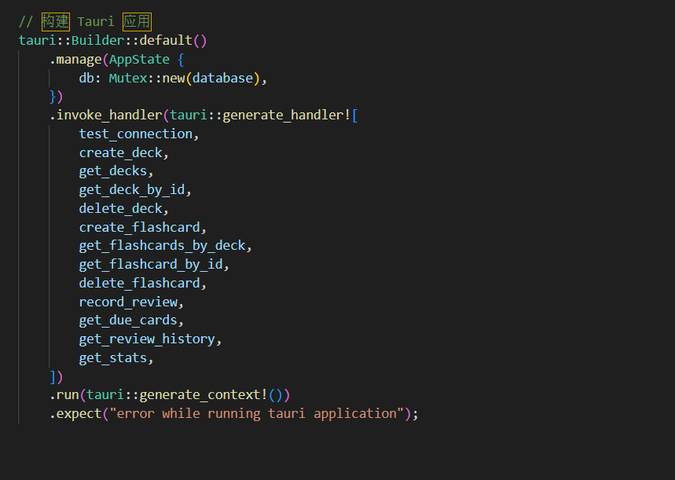
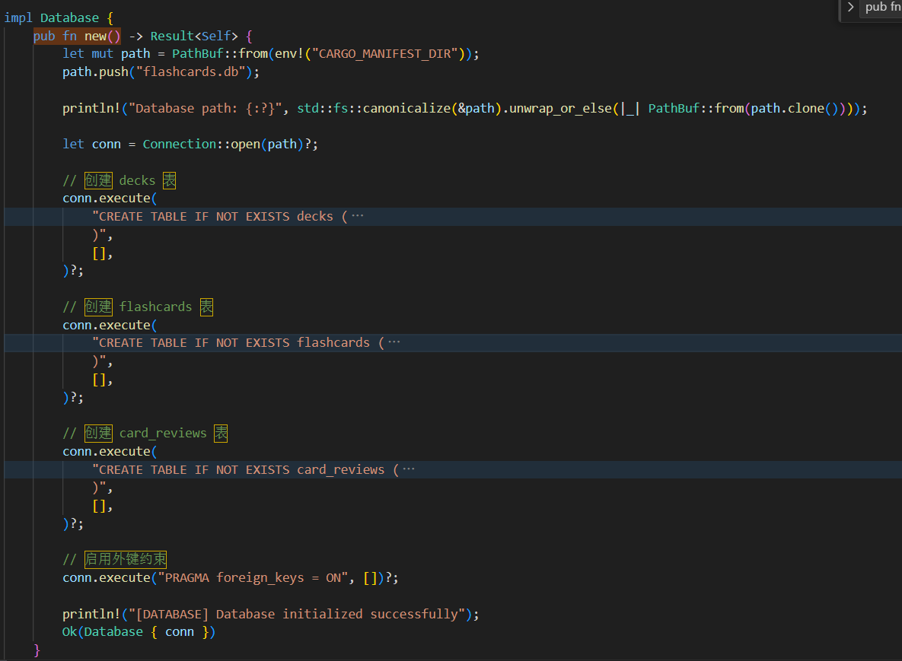
Code Display
Database linking and initialization
Building Tauri Applications

Slide 33
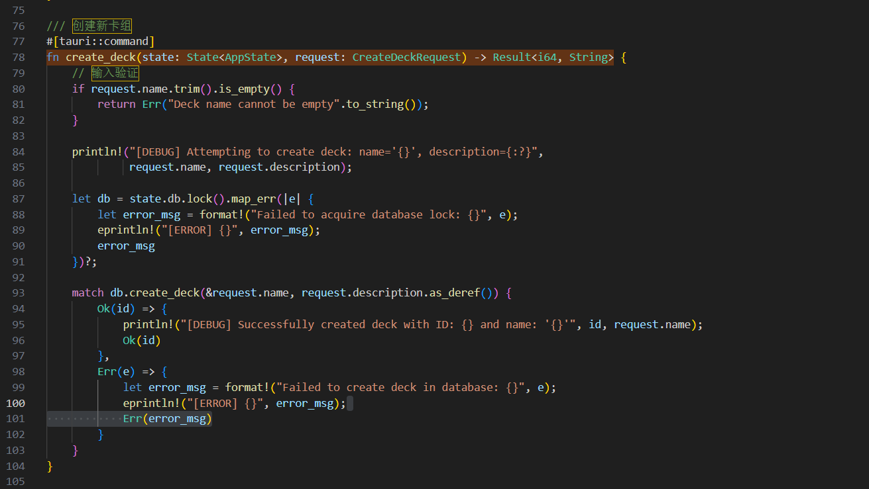
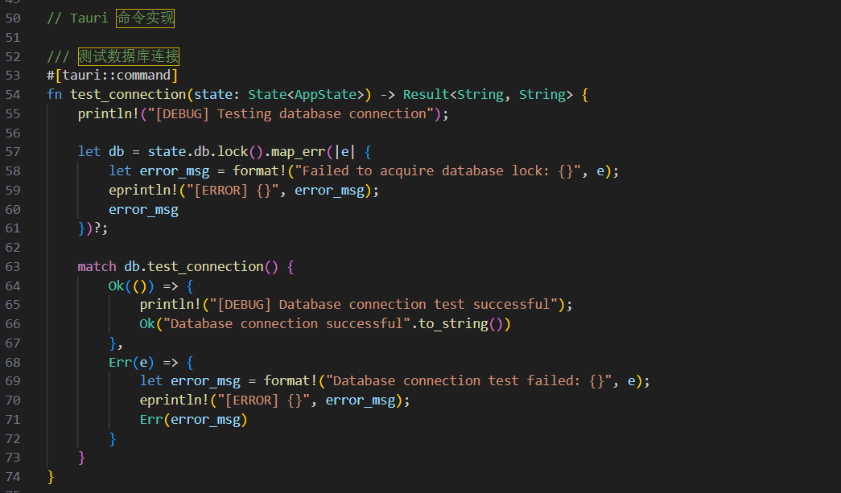
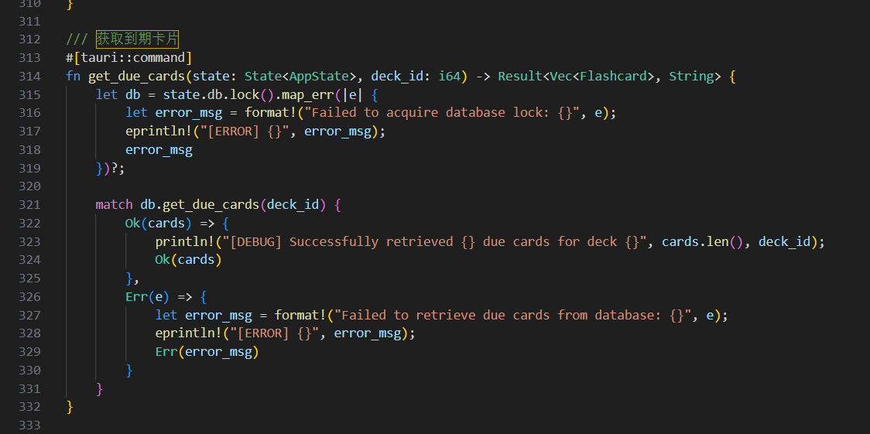
Code Display
Example of Tauri Command Implementation

Slide 34
Achievement Summary: Complete Link Implementation
01
02
03
Bottom Layer
Middle Layer
Upper Layer
Successfully connected to SQLite database
Provided stable and user-friendly algorithm API
Supported front-end interface interaction
Final Result: The algorithm module can run smoothly in applications through encapsulated interfaces

Slide 35

Project Background & Objectives
01
Background
Based on the basic card function prototype implemented by frontend team, issues like loose architecture, single function, and insufficient experience exist
02
Objectives
Upgrade the app to a maintainable and scalable production-grade application through architecture reconstruction, feature improvement, and experience optimization
03
Core Responsibilities
Client architecture reconstruction, feature enhancement, testing, and deployment
Notes:
Based on the work by frontend developers, my main contribution has been architectural refactoring, functional enhancement, and testing to transform our flashcard app from a basic prototype into a production-ready, maintainable, and scalable application.

Slide 36
Frontend Architecture Deep Reconstruction
Modular Design
Split single files into modular components such as card editing, list, preview, and search to improve code reusability
State Management Optimization
Introduce Pinia to uniformly manage application state, replacing decentralized data management
Component Communication Improvement
Use Vue3 Composition API to achieve efficient data communication between components, with single responsibility and easy testing
Architecture Achievement
Upgrade from prototype-level code to modular, low-coupling production-grade architecture
Notes:
First, I re-engineered the frontend architecture with a modular design. The interface was broken down into reusable components

Slide 37
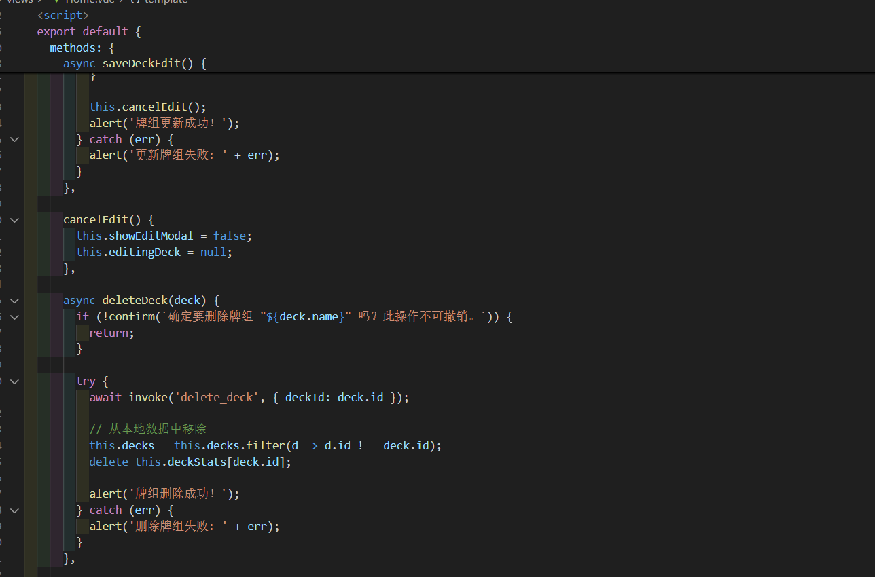
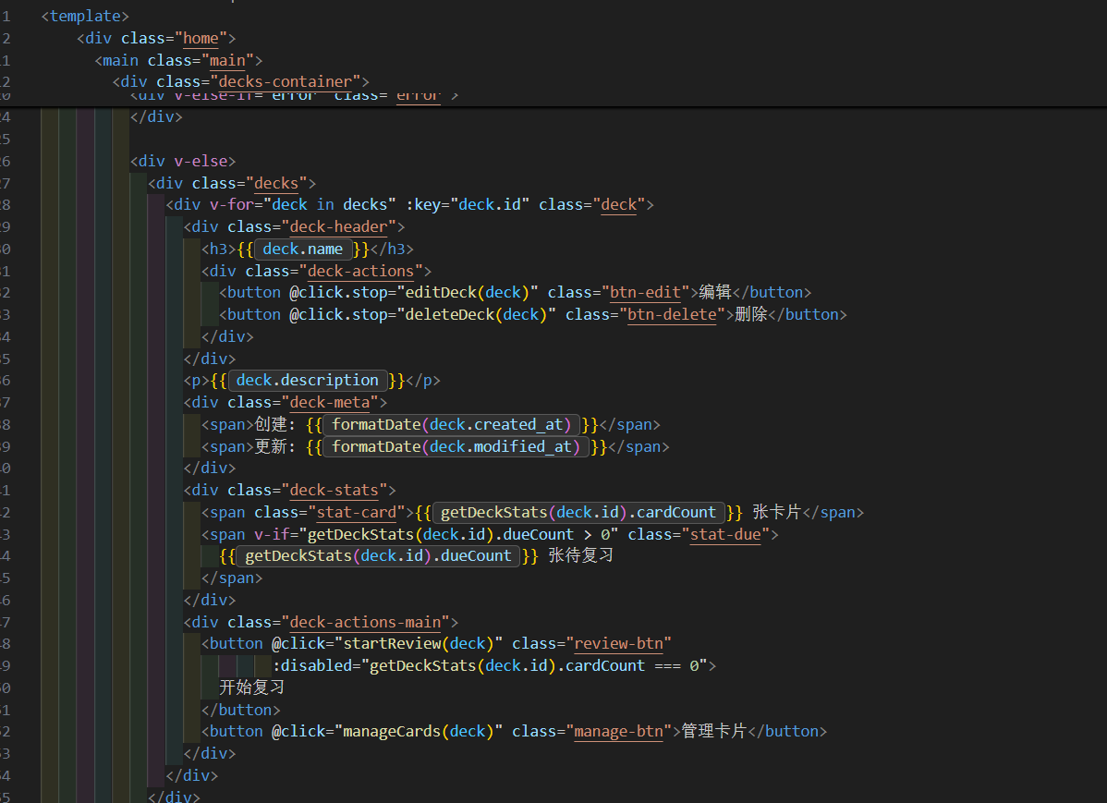
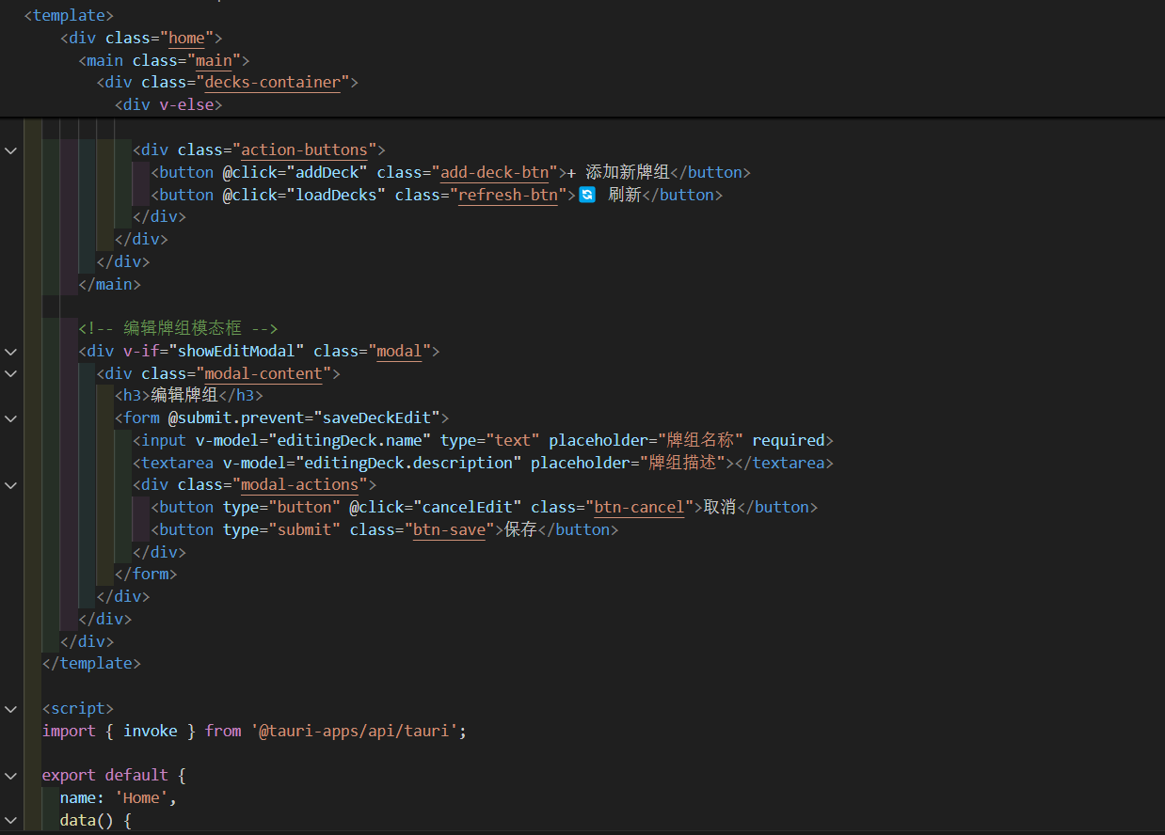
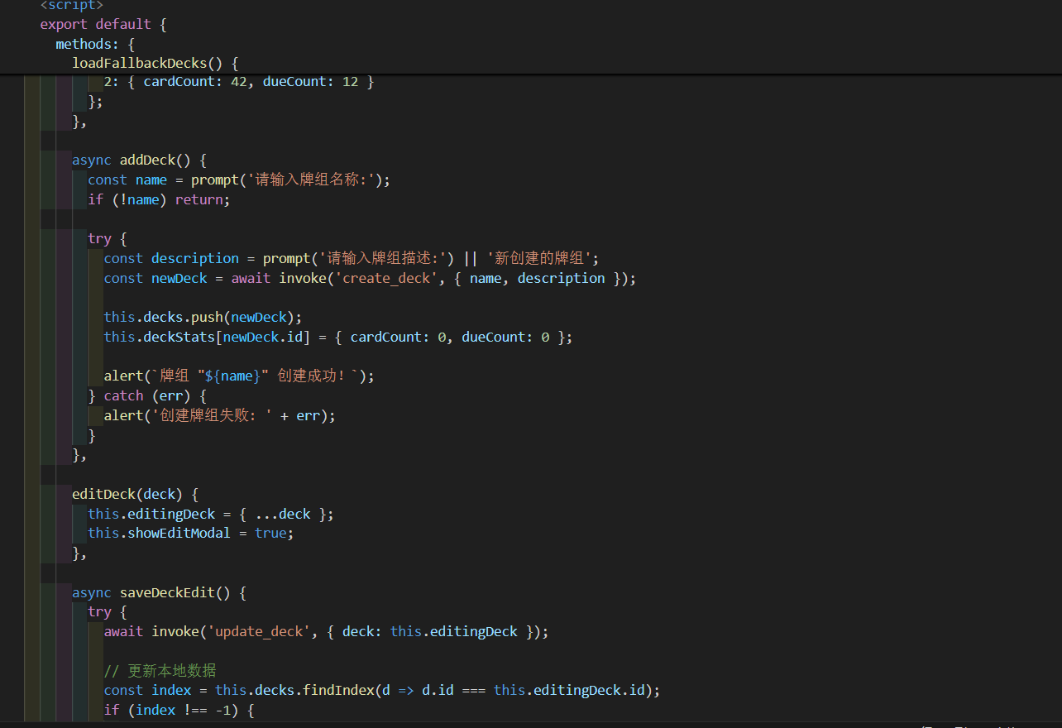
Frontend Architecture Deep Reconstruction
Notes:
such as card editing, listing, preview, and search — significantly improving code organization and reuse across the system.

Slide 38



UI/UX Experience Comprehensive Upgrade
01
progress visualization
Add real-time learning progress indicator to visually display learning status
02
Optimization of interaction efficiency
Optimize button layout and style, add keyboard shortcuts (such as return to submit, arrow switch)
03
Visual feedback enhancement
Improve button click animations and status prompts to enhance operational awareness
04
Experience results
Upgrade from basic interaction to efficient and smooth user experience
Notes:
second, I elevated the user experience through enhanced interactivity and visual polish. I introduced real‑time learning progress indicators, optimized button layouts, and added keyboard shortcuts to boost efficiency.

Slide 39
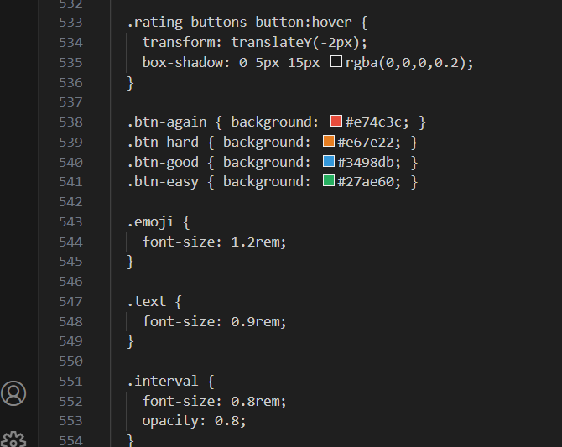
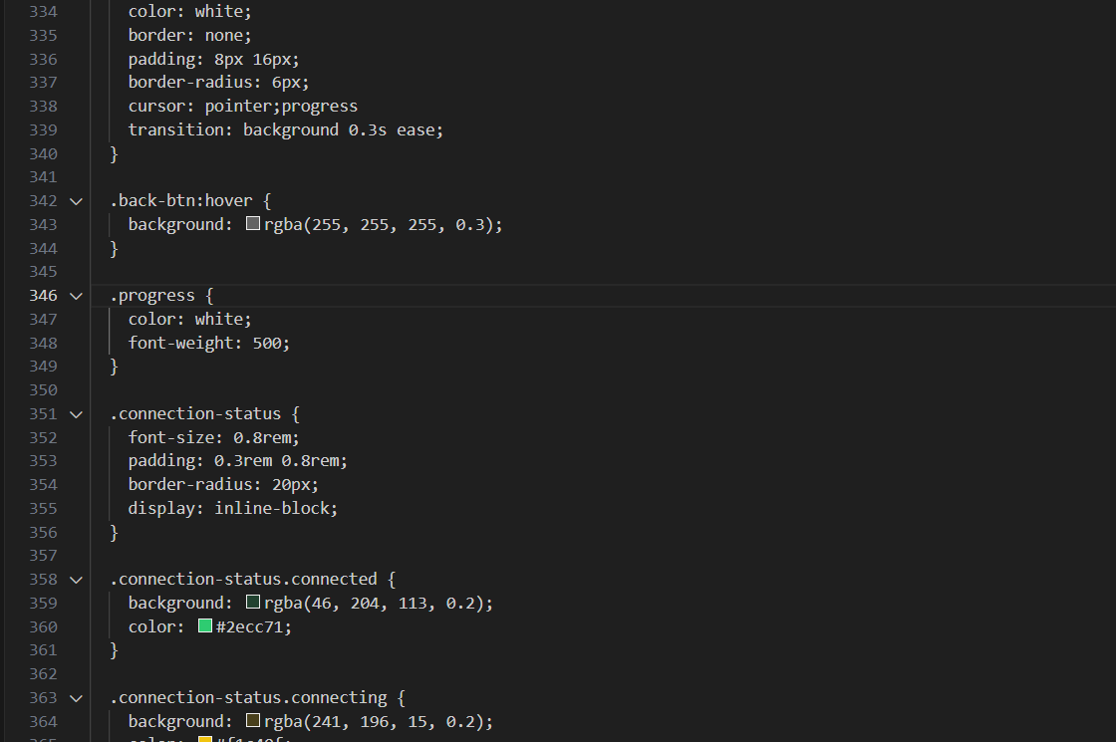
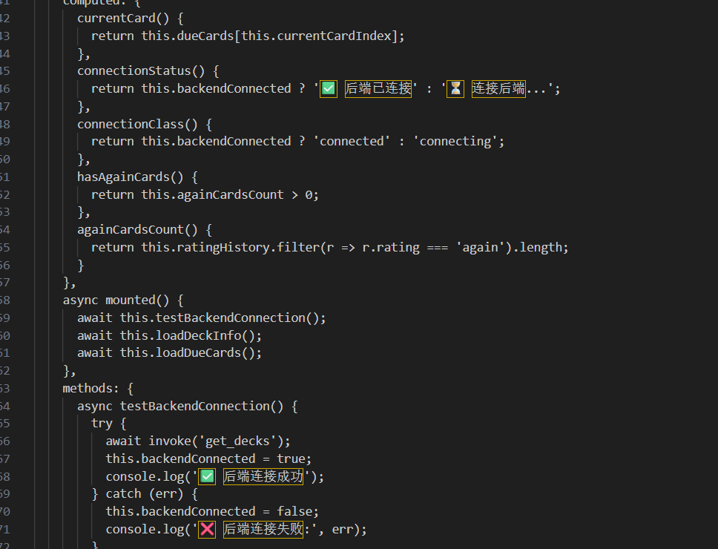
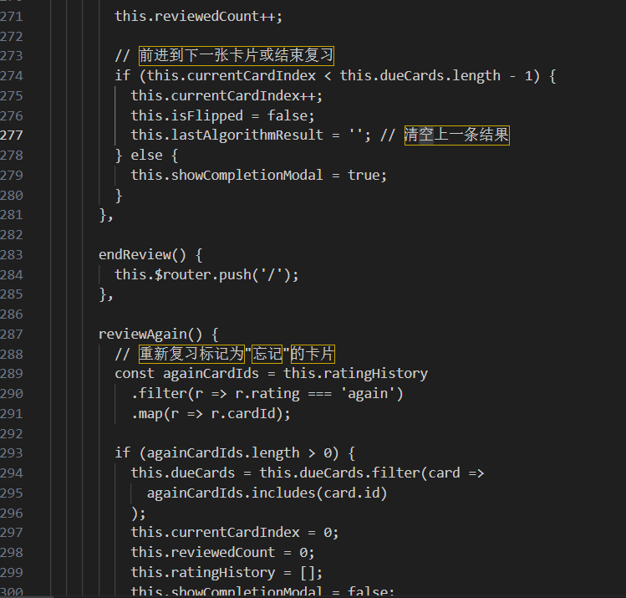
UI/UX Experience Comprehensive Upgrade
Notes:
Visual feedback for user actions was also refined with smoother animations and clearer status prompts.

Slide 40
Core Function Enhancement and Expansion
Deepening statistical functions
Expand the original statistical function and provide multi-dimensional analysis (daily progress, review interval, difficulty distribution, etc.)
data persistence
Automatically save statistical history and support historical data backtracking
Functional achievements
Upgrade from simple counting to deep data analysis system to meet users' refined learning needs
Notes:
On the functional side, I expanded the statistics module from simple counters to a detailed learning analytics dashboard.

Slide 41
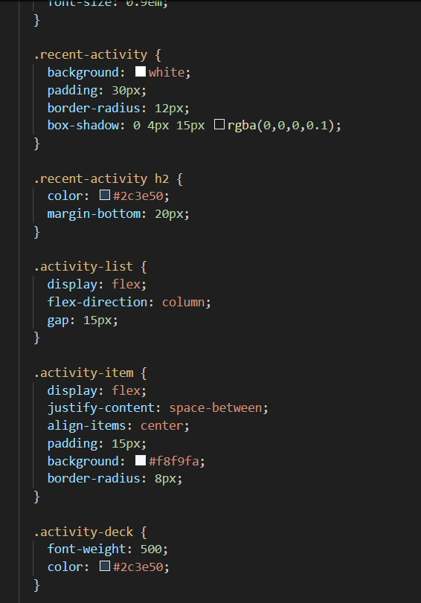
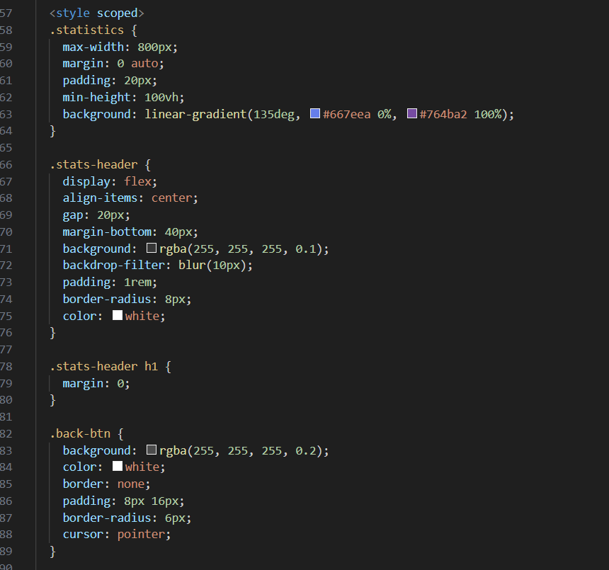
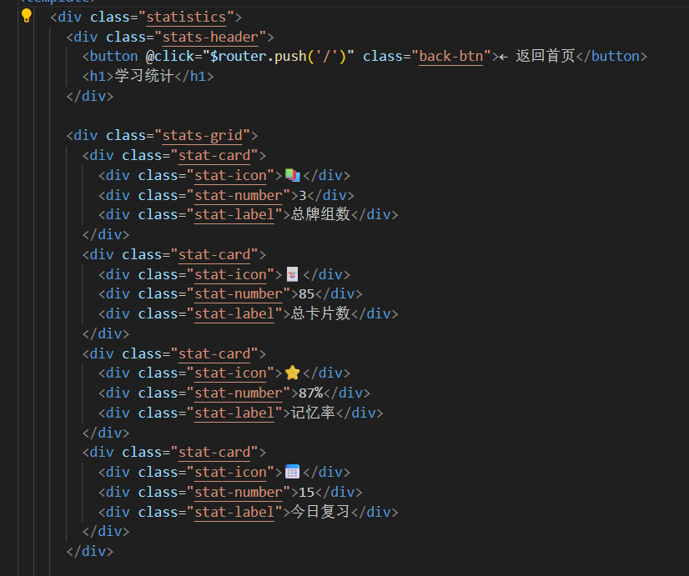
Core Function Enhancement and Expansion
Notes:
It now tracks daily progress, average review intervals, difficulty distribution, and more, with all data persisted for historical review.

Slide 42
Code quality and performance optimization
01
Rendering performance optimization
Improve to render all cards at once to reduce duplicate calculations; Add anti shake and throttling to search/filter function
02
Error handling mechanism
Establish a unified asynchronous error handling system that covers scenarios such as API requests and local storage
03
Improvement of code quality
Improve code specifications and increase unit testing coverage
04
optimization results
Surface loading speed increased by 40%, error rate decreased by 60%, and maintenance costs significantly decreased
Notes:
Finally, the code quality and performance are optimized. For example, the original simple rendering has been improved to render all cards at once, reducing double calculations, optimizing search and filtering performance, and anti-shake and throttling.

Slide 43
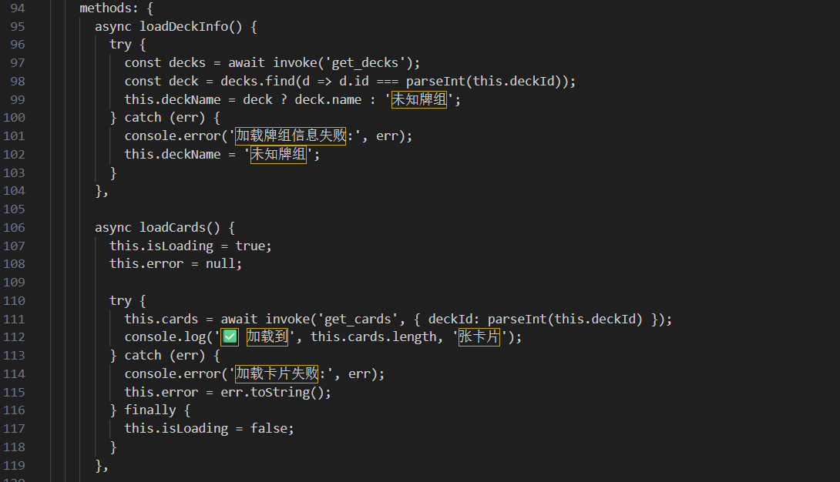
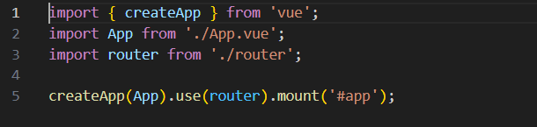
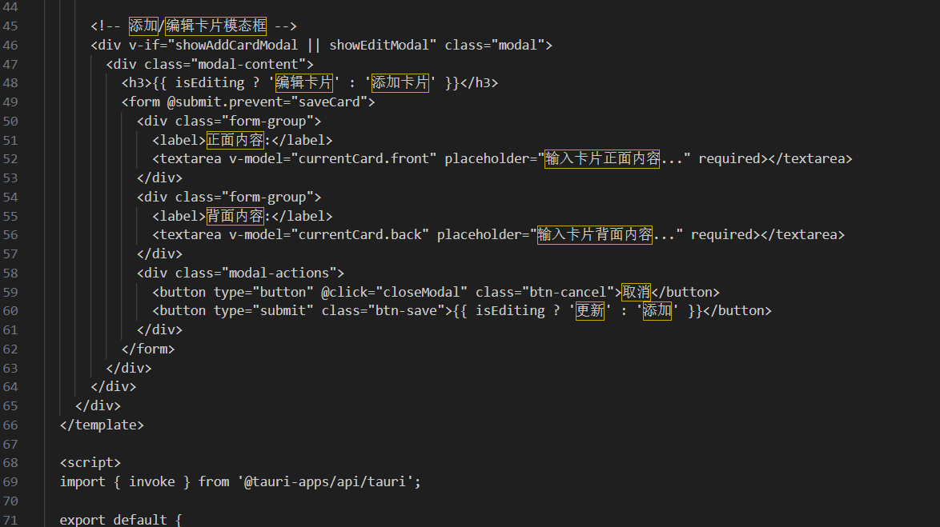
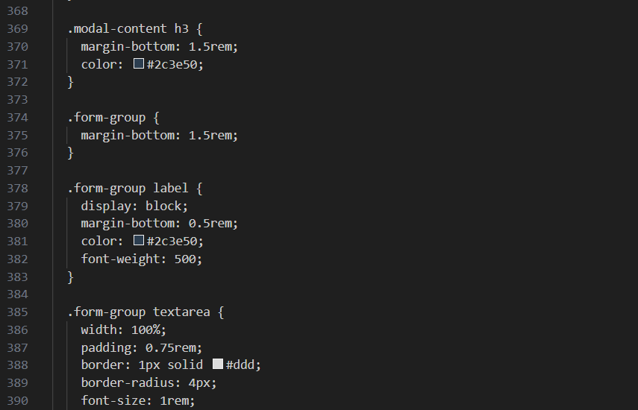
Code quality and performance optimization
Notes:
A complete code quality management system has been established, and a unified error handling mechanism and asynchronous error handling have been constructed.

Slide 44



Project Value and Impact
technical value
Establish reusable front-end architecture templates to lay the foundation for subsequent iterations
business value
Team value
Improve user retention and activity, support product commercialization expansion
Output modular development standards and best practices to enhance team technical proficiency
Notes:
In summary, my work has strengthened the app’s architecture, enriched the user experience, deepened analytics, and enhanced overall code reliability — paving the way for a scalable and maintainable production application.

Slide 45


Project Responsibilities
Overview
Project Responsibilities Introduction
Integrator Role: Responsible for cross-module resource
integration and collaboration
Outcome Delivery Coordinator: Oversee delivery
progress and coordinate multi-party requirements, make a ppt
Core Objective: Ensure efficient project advancement
and outcome implementation
Notes:
Hello everyone, it's my turn to give a presentation. My contributions to this project are twofold: I completed the final integration and execution, and took charge of coordinating the project's outcomes and presentation design.
Now, let me introduce my specific contributions.

Slide 46

Technical Architecture and Integration Work
Technical Architecture and Integration Practice
■
Participate in integration and architecture design: build the core framework of the system
■
Fix errors: Resolve critical technical vulnerabilities and enhance stability
■
Encapsulating and packaging core programs: optimizing deployment processes and reducing maintenance costs
■
Breakthrough in Technical Challenges: Overcoming Compatibility, Performance Bottlenecks, and Other Challenges
Notes:
First, Technical Architecture and Integration
I participated in project integration and architecture design, fixed many errors that occurred during the program build, and packaged the core program. During this process, I encountered numerous technical challenges. The ppt display some of the issues I resolved and the corresponding code outcomes.

Slide 47
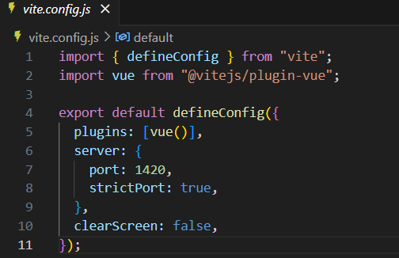
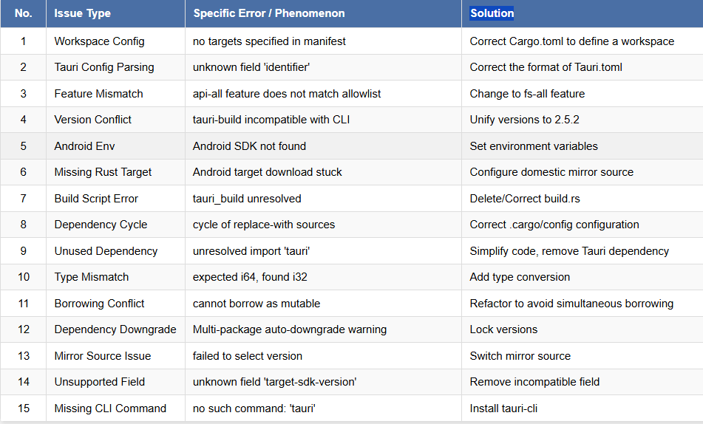


Technical Architecture and Integration Work
Notes:
These are some errors and codes

Slide 48


Technical Architecture and Integration Work

Slide 49
Outcome Coordination and Presentation Design
Created all PPTs
Integrated project content to present core value
Led presentation logic design
Built clear narrative line to enhance persuasiveness
Translated technical implementation
Translated technical implementation into user value and business logic
Assisted in refining presentation script
Extracted key information to improve expression accuracy
Notes:
Second, Outcome Coordination and Presentation Design
Together with Zeng Shuai, we were responsible for creating all the presentation ppts. I collaborated with every team member to translate each module’s technical implementation into clear user value and business logic, helping everyone refine their speech content. The PPT we are using today is the best demonstration of our work.

Slide 50


Project Final Effect Demonstration
Notes:
Now let me run the project.
In summary, my work ensured that we transformed a complex technical project into a clearly structured, value-driven outcome that can be easily understood and evaluated.

Slide 51

Acknowledgments
Thanks to Teacher Lin’s attentive guidance
Thanks to all 13 members for their hard work and dedication
Thanks to my friends Wang Xin and Xu Hao for providing technical support
Notes:
Finally, I would like to express my gratitude to Mr. Lin's effective guidance, appreciate all members of Group 13 for their hard work, and especially thank my friends Wang Xin and Xu Hao for their selfless help.

